Slide 1
Software Engineering
Module: Web UI Programming
Topic: HTML

Slide 2
HTML Basics
The content in this presentation is aimed at teaching learners to:
Create hyperlinks that navigate to different WebPages
Display data in a structured format using HTML tables
Notes:
Instructor Notes:
By the end of this course, participants should be able to:
<Obj1>
<Obj 2>

Slide 3
Hyper Links
Use anchor tag <a> to create a link.
<a href="url">Text to be displayed</a>
The href attribute is used to indicate the page we are linking to.
The target attribute defines where the linked document will be opened.
_blank, _parent, _self, _top, frame_name can be the values of the target attribute.
<a href="url“ target=“_blank”>Text to be displayed</a>

Slide 4
Hyper Links
Anchor Tag
Targeting
Anchor Tag
<a href=“www.google.com” target=“_blank” name=“glink”>
Google Pages </a>
Hyperlink URL
Anchor Tag
Naming

Slide 5
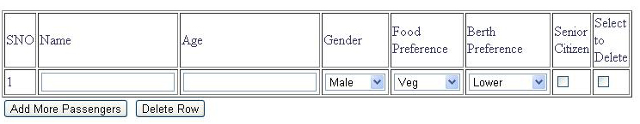
Tables
An HTML table is an element comprised of rows and columns
Tables are container elements, and their sole purpose is to house other HTML elements and arrange them in a tabular fashion -- row by row, column by column

Slide 6
Tables
<table> tag defines the table
<tr> tag divides the table into rows
<td> tag divides the rows into cells
A data cell can contain text, images, lists, paragraphs, forms, horizantal rules, tables, etc.

Slide 7
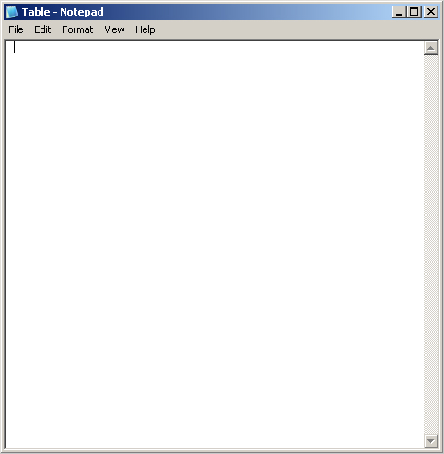
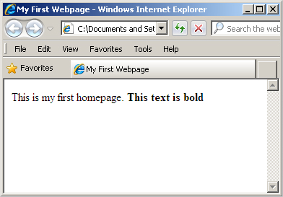
Tables
A Simple Table
<table>
<tr>
<td>row 1, cell 1</td>
<td>row 1, cell 2</td>
</tr>
<tr>
<td>row 2, cell 1</td>
<td>row 2, cell 2</td>
</tr>
</table>
row 1, cell 1 row 1, cell 2
row 2, cell 1 row 2, cell 2

Slide 8
Tables
Table with Border Attribute
<table border=“2">
<tr>
<td>Row 1, cell 1</td>
<td>Row 1, cell 2</td>
</tr>
</table>
row 1, Cell 1 | row 1 Cell 2

Slide 9
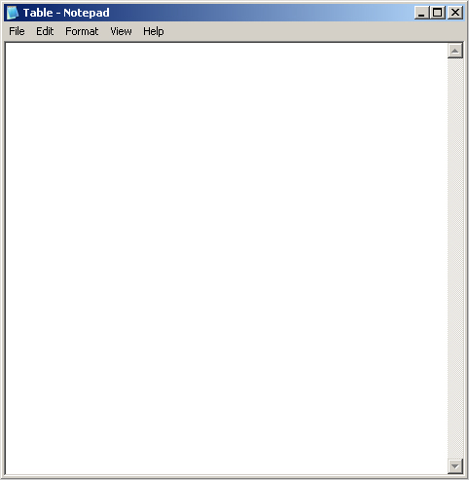
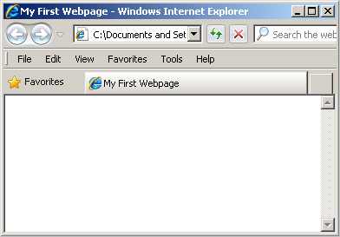
Tables
Table with Heading
<table border=“2">
<tr>
<th>Heading</th>
<th>Another Heading</th>
</tr>
<tr>
<td>row 1, cell 1</td>
<td>row 1, cell 2</td>
</tr>
<tr>
<td>row 2, cell 1</td>
<td>row 2, cell 2</td>
</tr>
</table>
Heading | Another Heading
row 1, cell 1 | row 1, cell 2
row 2, cell 1 | row 2, cell 2

Slide 10

Tables
Cell Padding
Cell Padding specifies the space between the cell wall and the cell content in pixels.
<table border=“5"
cellpadding="10">
…..
</table>

Slide 11

Tables
Cell Spacing
Cell Spacing Specifies the space between cells in pixels.
<table border=“5"
cellspacing="10">
….
</table>

Slide 12
Tables
table width
The width attribute can be used to define the width of a table
It is defined as a fixed width in pixels irrespective of window size
A relative table width is specified as a percentage of the width of the viewing window.
Example:
<table width=“550px”>….</table>
Or
<table width=“80%”>….</table>

Slide 13
Tables
Colspan and Rowspan
Table cells can span across more than one column or row
- COLSPAN defines number of columns across
- ROWSPAN defines number of rows down
Columns
Rows

Slide 14
Tables
Colspan Example
<table>
<tr>
<td>1</td><td colspan=2>2 3</td>
</tr>
<tr>
<td>4</td><td>5</td><td>6</td>
</tr>
<tr>
<td>7</td><td>8</td><td>9</td>
</tr>
</table>
1 | 2 3
4 | 5 | 6
7 | 8 | 9

Slide 15
Tables
Rowspan Example
<table>
<tr>
<td>1</td><td rowspan=2>2 <br>
5</td><td>3</td>
</tr>
<tr>
<td>4</td><td>6</td>
</tr>
<tr>
<td>7</td><td>8</td><td>9</td>
</tr>
</table>
1 | 2 5 | 3
4 |  | 6
7 | 8 | 9

Slide 16
Tables
Rowspan and Colspan Example
<table>
<tr>
<td>1</td><td rowspan=2 colspan=2>
2 3<br> 5 6</td>
</tr>
<tr>
<td>4</td>
</tr>
<tr>
<td>7</td><td>8</td><td>9</td>
</tr>
</table>
1 | 3 6
4
7 | 8 | 9

Slide 17

HTML Navigation and Tables

